Slide 1
The distribution and host range of the pandemic disease chytridiomycosis in Australia, spanning surveys from 1956–2007
Ashwini Ramesh
Evgeniya Polezhaeva
INDIANA UNIVERSITY BLOOMINGTON

Slide 2
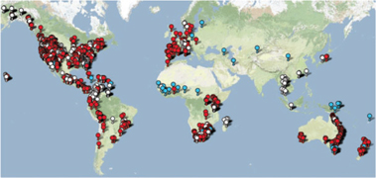

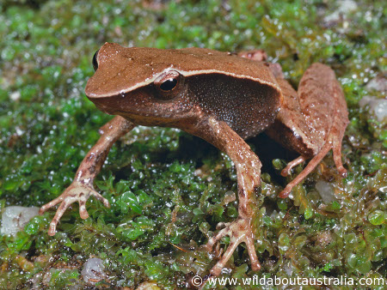
Introduction
Chytridiomycos is infectious disease of amphibians caused by an aquatic fungal pathogen:
Batrachochytrium dendrobatidis
Bd may be responsible for the greatest disease-caused loss of biodiversity
Only in Australia: 4 frog species extinct, 10 species are threatened.
350 amphibian species are known to have been infected by Bd
Bd introduced into Australia ~1978
Predictive modeling, meta-analyses, and risk assessment
essential knowledge for conservation management
The sharp-snouted torrent frog Taudactylus acutirostris, extinct

Slide 3
Click to add engaging text
SECTION TITLE GOES HERE IF NECESSARY
Make your concise point here.
Slides with multiple paragraphs of text have shown to significantly decrease the attention of the audience.
Let your slides breathe — it lets the audience listen to you.

